Slide 1

PROJECT OVERVIEW AND KEY LEARNING OUTCOMES
EASY
ADVANCED

Slide 2
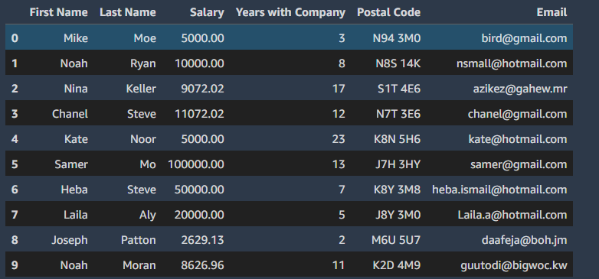
PROJECT OVERVIEW AND LEARNING OUTCOMES
We will analyze corporate employee information using Pandas in Jupyter Notebooks in AWS SageMaker Studio.
We will learn how to:
Select Specific Columns from the DataFrame
Add/Delete Columns from the DataFrame
Perform Label/integer-based elements selection
Perform broadcasting operations
Perform Pandas DataFrames sorting/ordering

Slide 3
PROJECT DEMO
EASY
ADVANCED

Slide 4
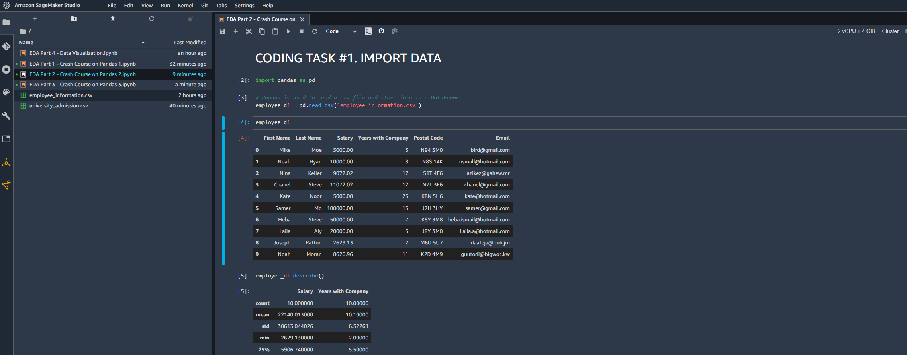
PROJECT DEMO

